Slide 1
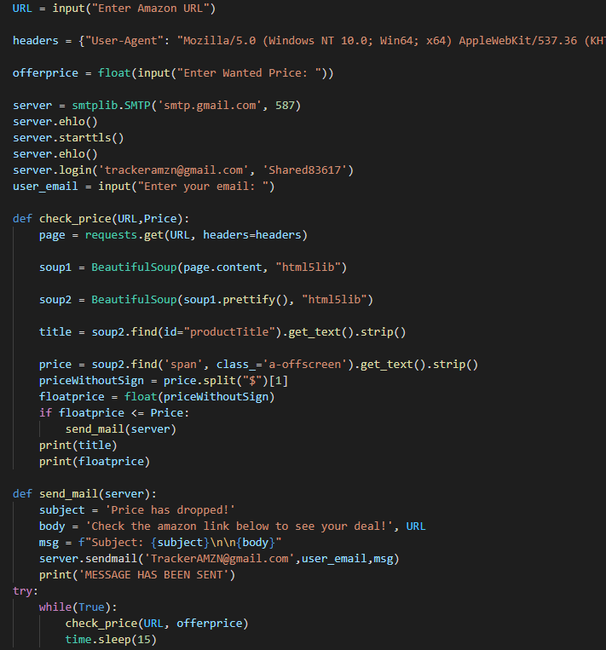


Amazon Price Tracker
Prices are ready when you are!
https://github.com/ksu-is/Amazon-Price-Tracker
Created By Frank Anello and Vladimir Juarez-Zayas
Lets users input an Amazon URL and at what price point to email them when it is on sale!

